Slide 1














AI assisted vision-based model for improved safety
Presented by
Mukunthan S - 21011102065
R Porselvi - 21011102077
Vikas - 21011102118
Dr K Surya
Shiv Nadar University Chennai

Slide 2


Problem statement
Traditional safety monitoring methods are time-consuming and prone to human error, risking worker safety.
This project aims to automate the detection of helmets, masks, and vests using deep learning.
Key challenges include adapting to varying lighting, handling occlusions, and managing multiple workers on-site, all while preserving privacy through anonymization.
Our objective is to enhance safety protocols, reduce accidents, and streamline compliance in construction environments.

Slide 3




OBJECTIVE
Real-Time Detection: Develop a deep learning model to detect helmets, safety vests, and masks on construction workers.
Automated Safety Monitoring: Integrate the model with site surveillance to identify non-compliance without human intervention.
Automated Alerts: Capture evidence of non-compliance and send immediate alerts with images to supervisors.
Robustness & Accuracy: Ensure high accuracy, minimal false alerts, and adaptability to varying conditions and movements.
User Interface: Provide an intuitive interface for supervisors to review alerts and enforce safety protocols.

Slide 4


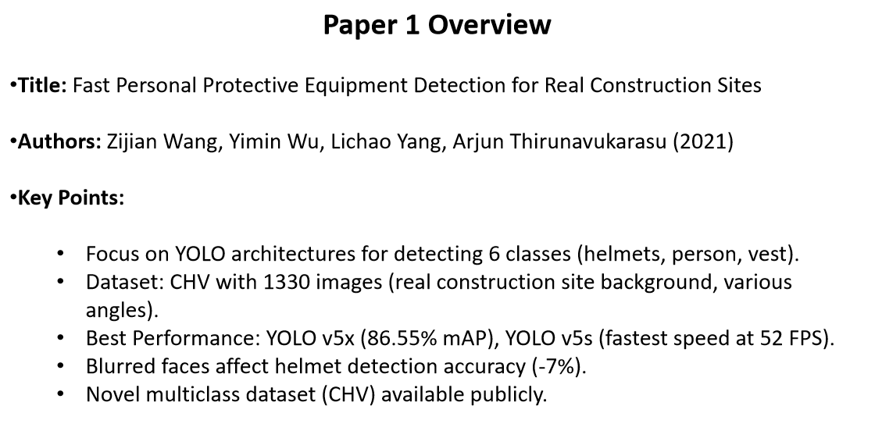
LITERATURE SURVEY

Slide 5
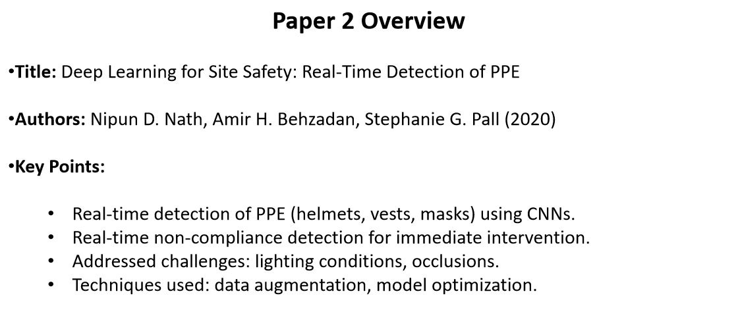
LITERATURE SURVEY

Slide 6
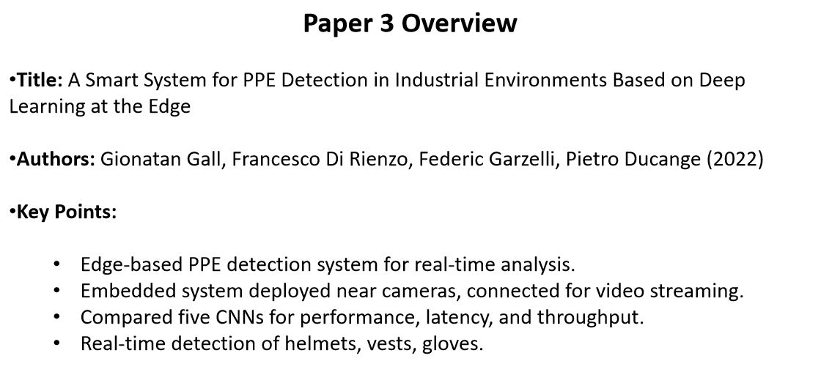
LITERATURE SURVEY

Slide 7
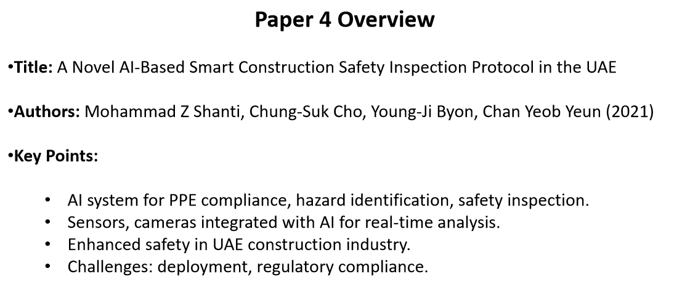
LITERATURE SURVEY

Slide 8
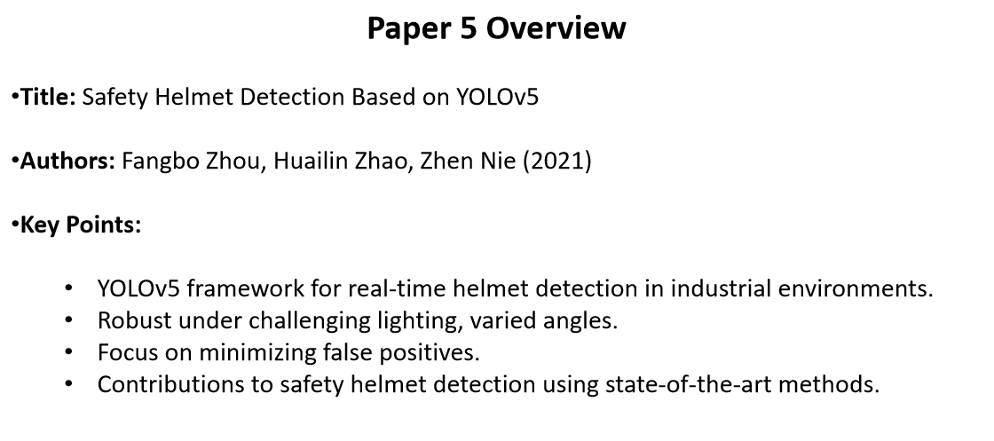
LITERATURE SURVEY

Slide 9


REQUIREMENT SPECIFICATION
PYTHON
ANACONDA
ANACONDA PACKAGE MANAGEMENT
JUPYTER NOTEBOOK

Slide 10
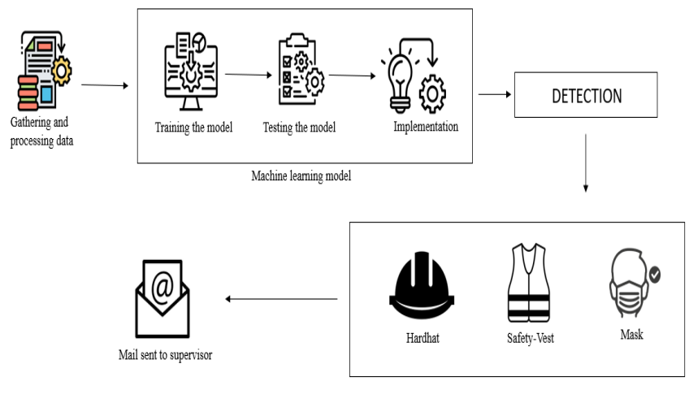

ARCHITECTURE DIAGRAM

Slide 11
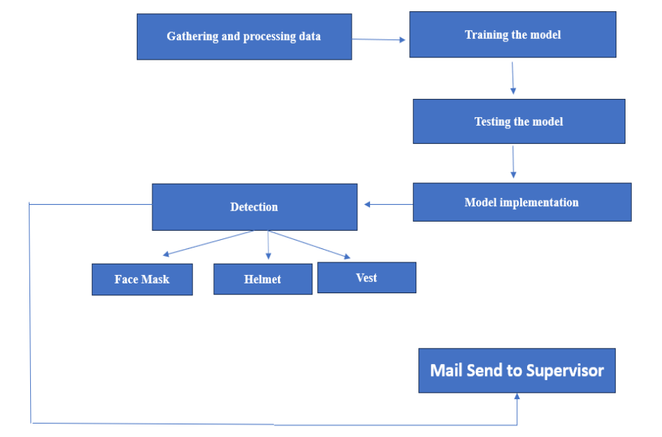
FLOW DIAGRAM

Slide 12
FUNCTIONAL DESIGN
MODULE LISTING
Data Collection
Training the Model
Testing the Model
Model Implementation and Detection
Sending Mail

Slide 13
FUNCTIONAL DESIGN
DATA COLLECTION
GOAL: ENHANCE CONSTRUCTION SITE SAFETY THROUGH ACCURATE DETECTION.
DIVERSE DATASET: ANNOTATED IMAGES, METADATA, AND REAL-TIME SURVEILLANCE DATA OF HELMETS, VESTS, AND MASKS.
DATA ACQUISITION: MANUAL AND AUTOMATED METHODS; VARIED CONDITIONS (LIGHTING, ANGLES).
CONTINUOUS UPDATE: REAL-TIME SURVEILLANCE INTEGRATION FOR FRESH DATA.
PROACTIVE ENFORCEMENT: TIMESTAMPED ALERTS WITH IMAGES OF NON-COMPLIANT WORKERS.
4O

Slide 14
TRAINING THE MODEL
MODEL ARCHITECTURE: YOLOV5 AND FASTER R-CNN FOR DETECTING HELMETS, VESTS, AND MASKS.
DATA PREPARATION: COLLECT AND LABEL DIVERSE IMAGES FOR SUPERVISED LEARNING.
LABELING: ANNOTATE IMAGES TO IDENTIFY THE LOCATION AND PRESENCE OF SAFETY GEAR.
MODEL OPTIMIZATION:
ITERATIVE TRAINING: ADJUST PARAMETERS THROUGH FORWARD AND BACKWARD PASSES.
ENHANCED PRECISION: IMPROVES DETECTION ACCURACY AND RECALL OVER TIME.
FINALIZATION: FINE-TUNE AND VALIDATE FOR ROBUSTNESS ACROSS VARIOUS SITE CONDITIONS.

Slide 15
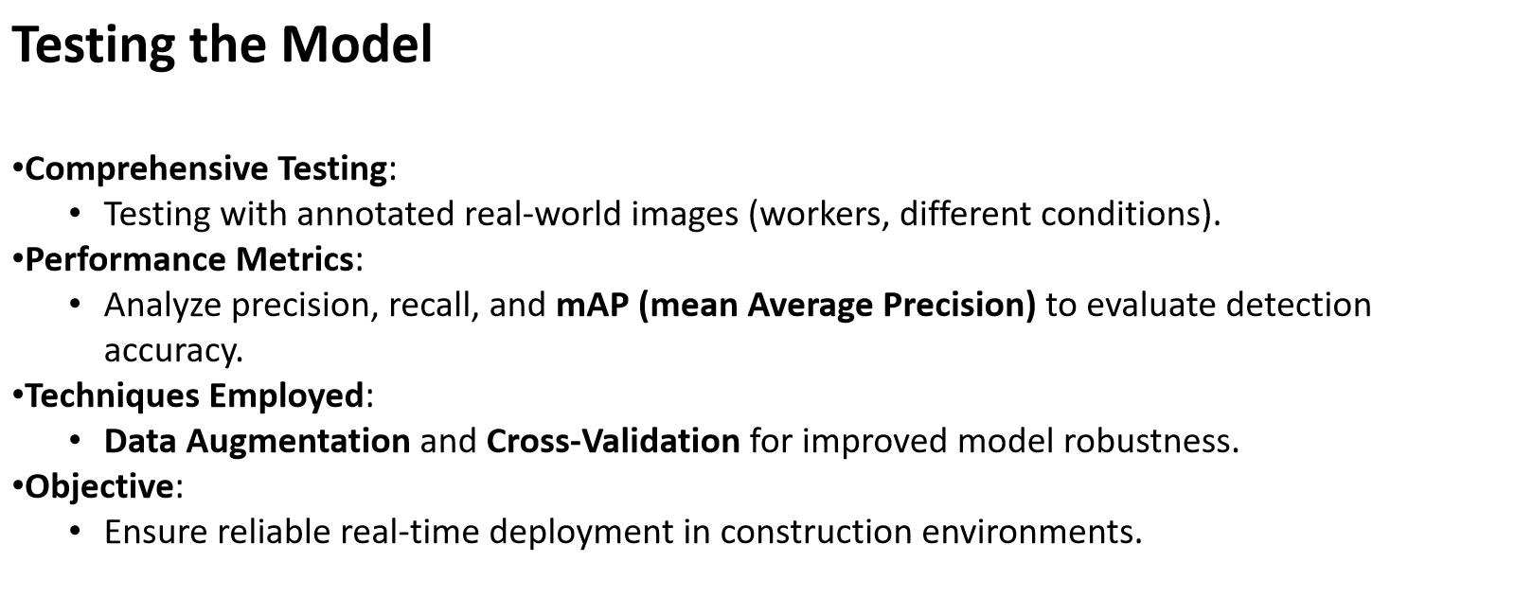
FUNCTIONAL DESIGN

Slide 16
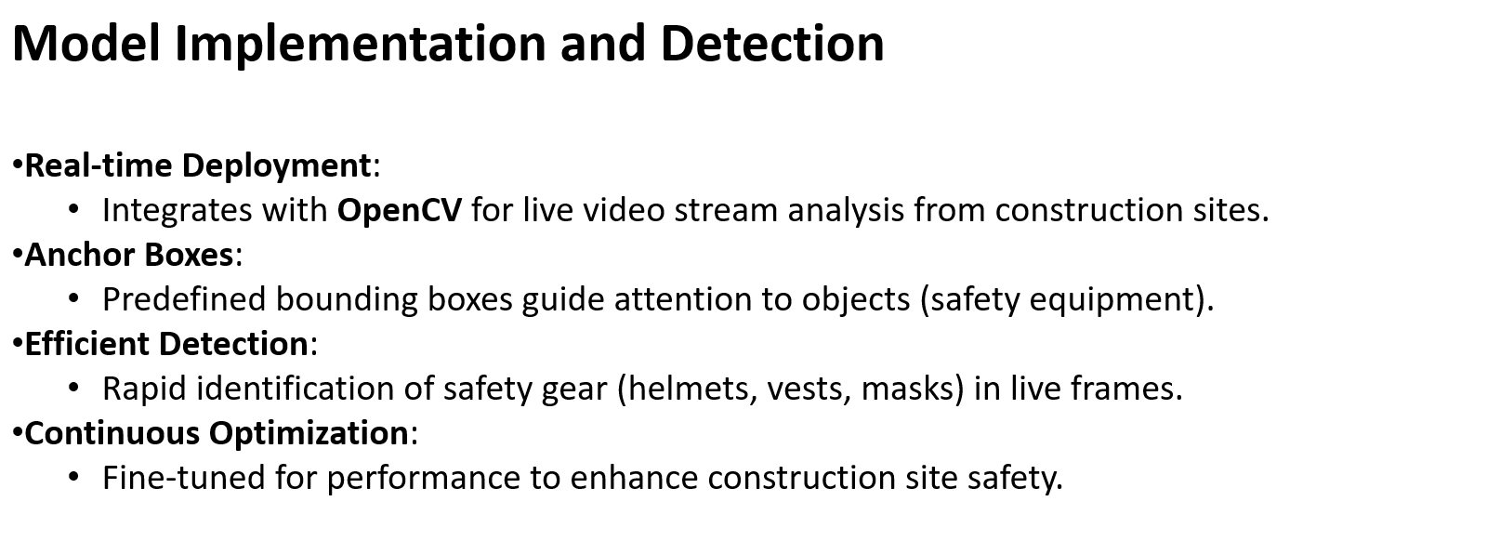
FUNCTIONAL DESIGN

Slide 17



Methodology
TORCH
OPENCV
SMTPLIB
MIME
DEEP LEARNING
FASTER R-CNN
YOLOV5
IMAGE PROCESSING

Slide 18

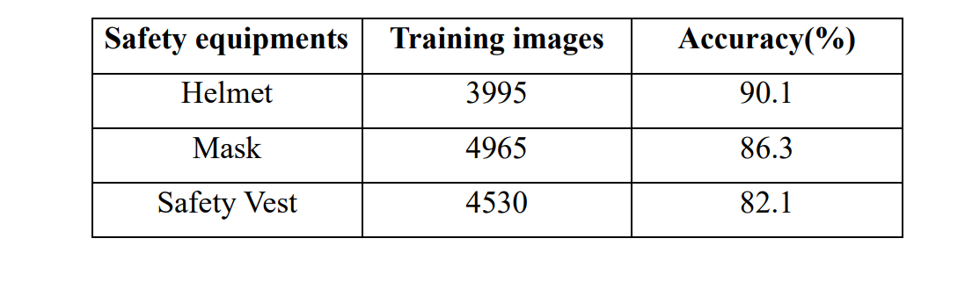
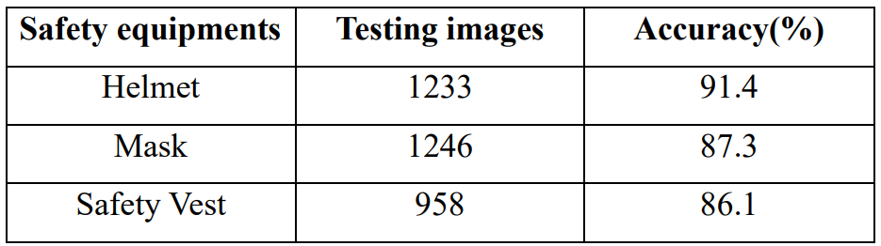
DATASET DETAILS
TRAINING ACCURACY
TESTING ACCURACY

Slide 19
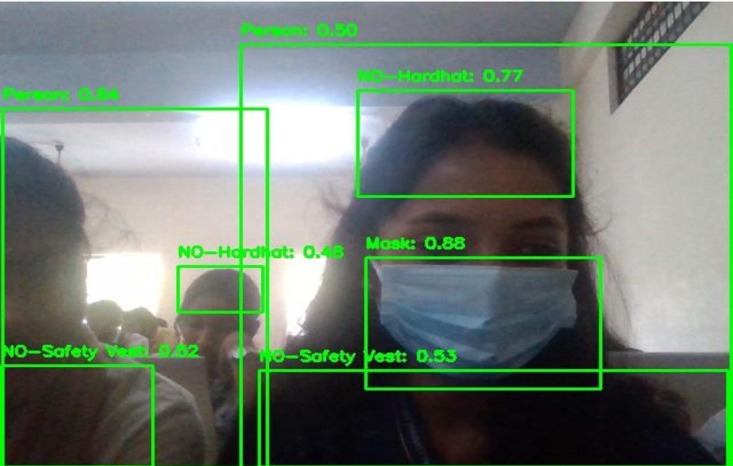
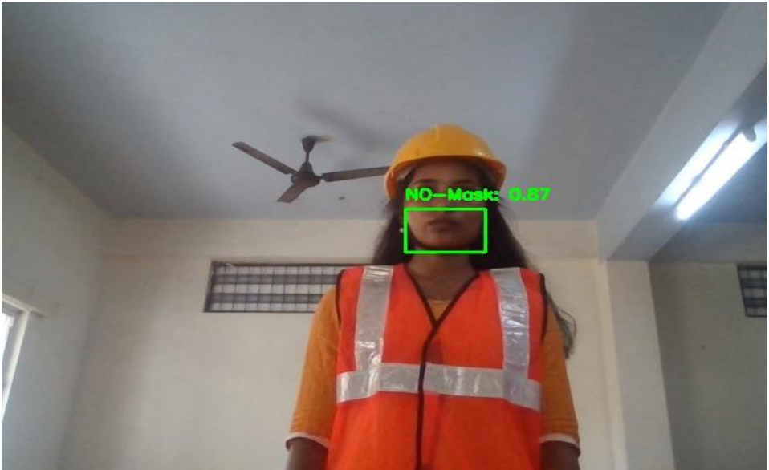
RESULT

